Slide 1
Getting Help
This section provides you with instructions on how to get help and report problems.

Slide 2
Help Resources
Runtime resources
  --help, --modhelp module[:class]
Troubleshooting page
  Documents warning and error messages
SF Wiki
  Latest documentation
  Searchable and you can make edits
SF Forums
  Questions not covered by Wiki
  All users see answer
SF user emails
  Ok, but not always as quick
  Other users don’t benefit from answer
SF TRAC
  Used if none of the above addresses the problem
  Used to report “bugs” or requested upgrades

Slide 3
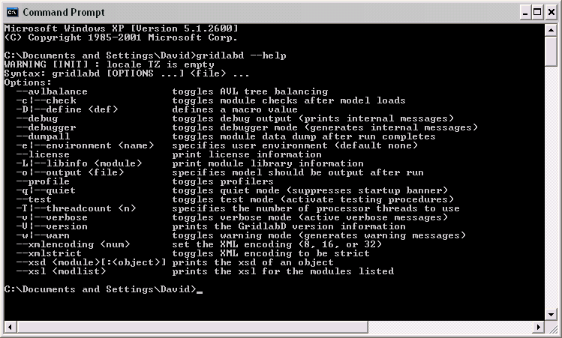
Example: --help option

Slide 4

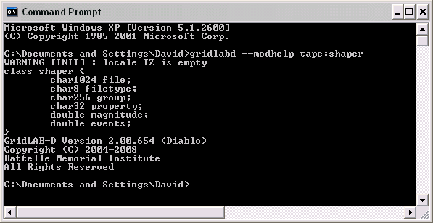
Example: --modhelp tape:shaper

Slide 5
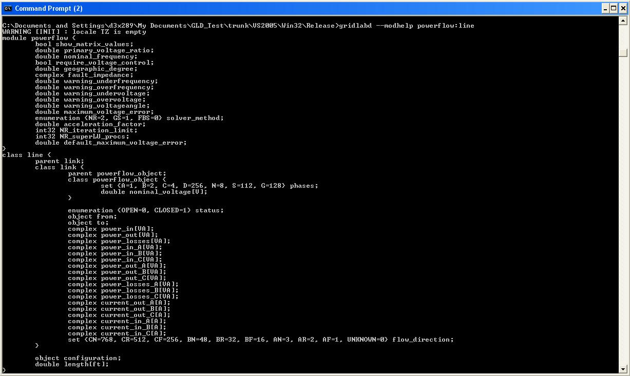
Example: --modhelp powerflow:line
Notes:
What is the purpose of this slide?

Slide 6
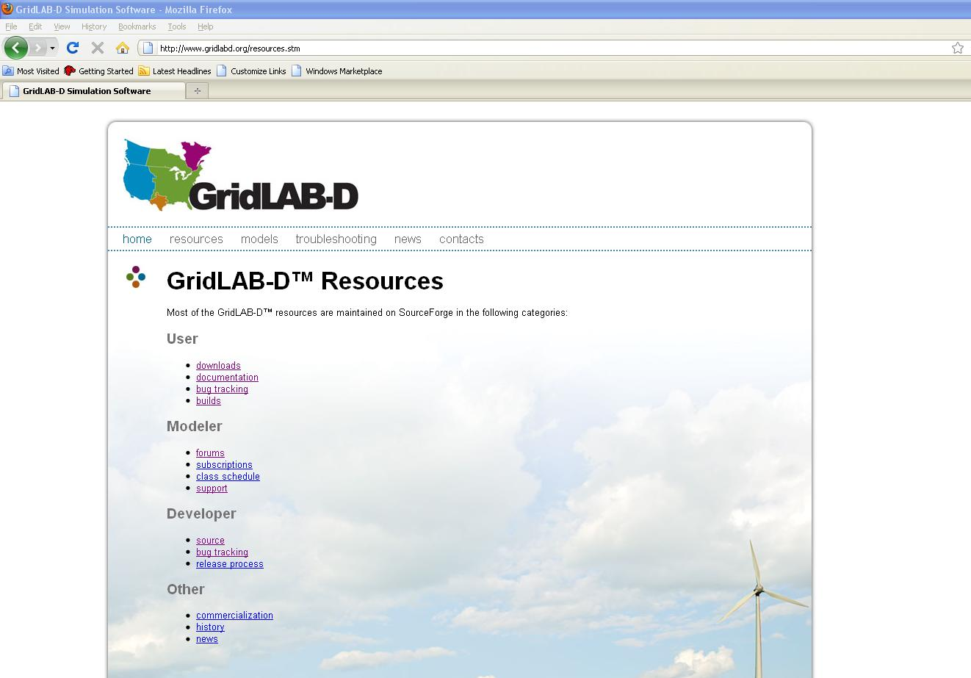


Slide 7
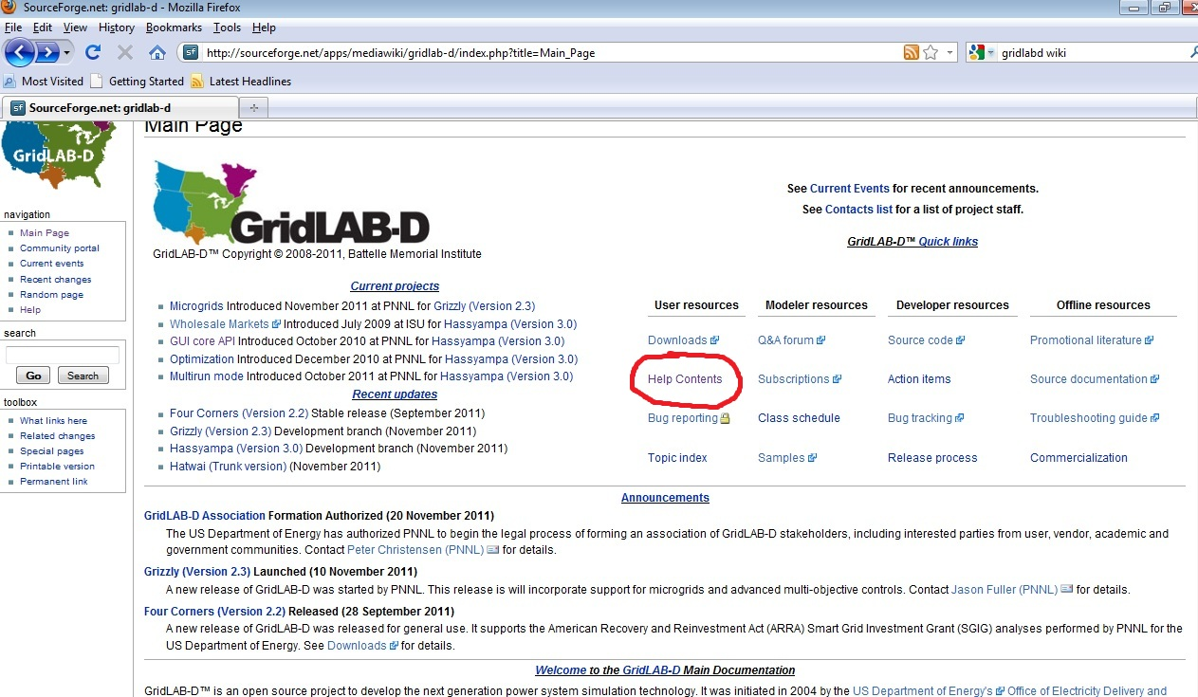

Slide 8
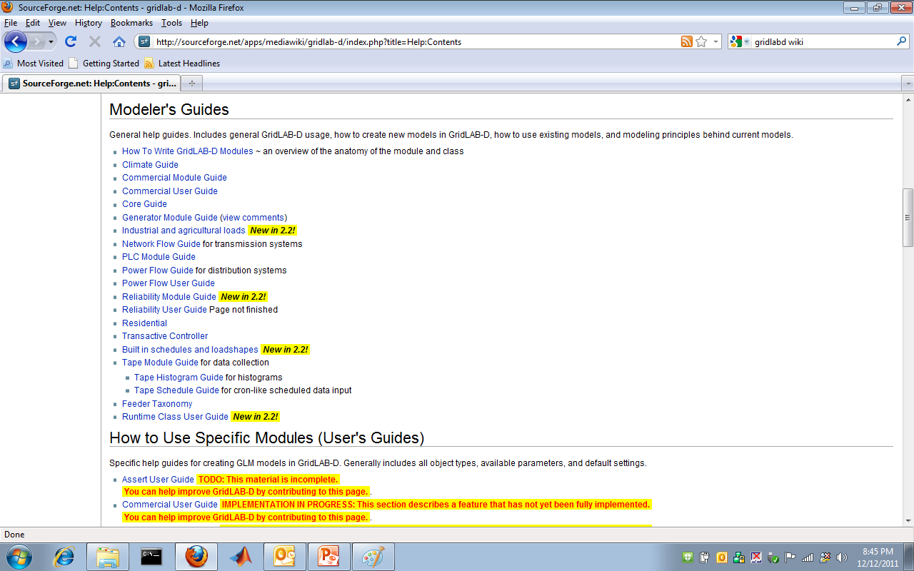

Slide 9
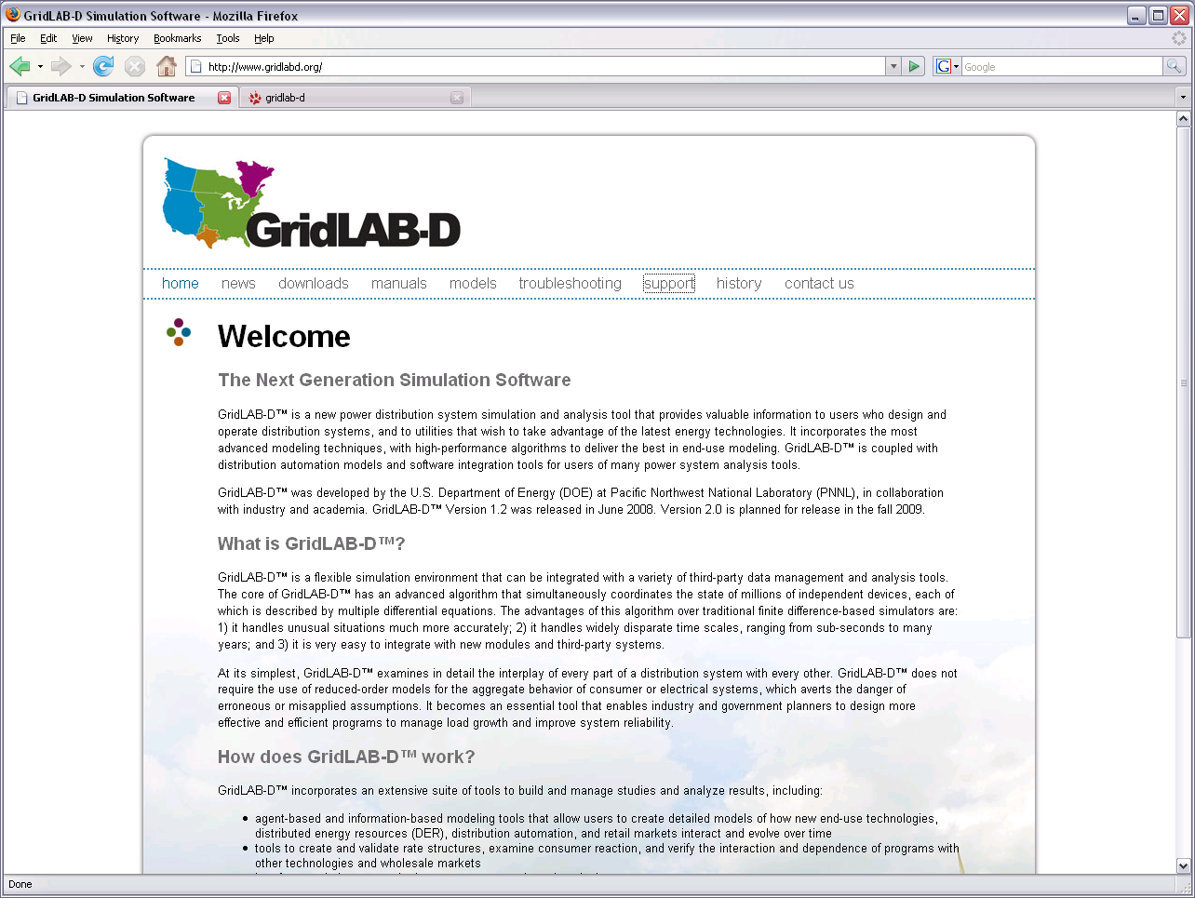



Slide 10
